Slide 1
Employee Data Analysis using Excel
STUDENT NAME:
REGISTER NO:
DEPARTMENT:
COLLEGE
JAISHREE.J
312209987
B.COM ( General )
VALLIAMMAL COLLEGE FOR WOMEN

Slide 2
PROJECT TITLE
Employee Performance Analysis using Excel
Analyzing employee performance using Excel can be done effectively with various tools and features that Excel offers. Here's a step-by-step guide to help you get started:

Slide 3


AGENDA
Problem Statement
Project Overview
End Users
Our Solution and Proposition
Dataset Description
Modelling Approach
Results and Discussion
Conclusion
3/21/2024 Annual Review

Slide 4

PROBLEM STATEMENT
Creating a problem statement for an analysis or project using Excel involves clearly defining the issue you're trying to solve or the objective you're aiming to achieve. Here's a template you can follow along with an example

Slide 5

PROJECT OVERVIEW
.
Creating a project overview using Excel involves summarizing key aspects of a project in a clear and organized manner. This overview helps stakeholders quickly understand the project’s scope, objectives, timeline, and status. Here’s how you can structure a project overview in Excel:

Slide 6

WHO ARE THE END USERS?
The end users of Excel can vary widely depending on the context, but they typically include:
1. Business Analysts
Use Case: Analyze data, create reports, and generate insights for decision-making.
Tasks: Financial modeling, forecasting, data visualization, and scenario analysis.

Slide 7

OUR SOLUTION AND ITS VALUE PROPOSITION
Problem: Sales teams at a mid-sized company are spending too much time manually generating reports and analyzing sales data. This manual process is prone to errors, inconsistent data formatting, and delays in providing actionable insights to management

Slide 8
Dataset Description
Describing a dataset in Excel is essential for understanding the structure, content, and purpose of the data. Here’s a guide on how to create a comprehensive dataset description

Slide 9

THE "WOW" IN OUR SOLUTION
PERFORMANCE LEVEL =IF(Z8>=5,”VERY HIGH”,IF(Z8>=4,”HIGH”,IF(Z8>=3,”MED”,IF(Z8<=2,”LOW”))))
3/21/2024 Annual Review
9

Slide 10
MODELLING
Modeling in Excel refers to the process of creating a mathematical or statistical representation of a real-world scenario, which can be used to analyze, predict, or optimize outcomes. Excel is a powerful tool for building such models because of its flexibility, built-in functions, and ability to handle complex calculations
10

Slide 11
RESULTS
Presenting Results Using Excel
GenderCode | (All)
Count of FirstName | Column Labels
Row Labels | HIGH | LOW | MED | VERY HIGH | Grand Total
BPC |  |  |  | 1 | 1
CCDR |  | 1 | 2 |  | 3
EW |  |  | 1 | 1 | 2
MSC |  | 1 | 1 |  | 2
NEL |  |  | 1 |  | 1
PYZ |  | 1 |  |  | 1
SVG |  |  | 1 |  | 1
TNS |  |  | 1 |  | 1
WBL | 2 |  | 1 |  | 3
Grand Total | 2 | 3 | 8 | 2 | 15
11

Slide 12
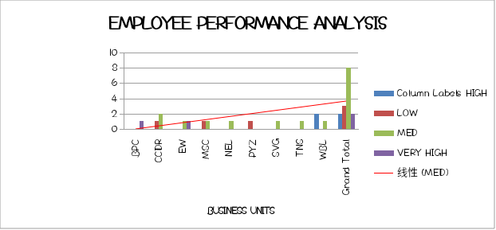

Slide 13
conclusion
When wrapping up any analysis, project, or presentation in Excel, the conclusion should succinctly summarize the key insights, findings, and recommendations. It should also provide a clear direction for the next steps or actions based on the analysis. Here’s how you can effectively craft a conclusion in Excel:

